Slide 1

Artificial Intelligence
CSE 191A: Seminar on Video Game Programming
Lecture 7: Artificial Intelligence
UCSD, Spring, 2003
Instructor: Steve Rotenberg

Slide 2
Video Game AI
Goals of game AI
  Be ‘fun’
  Run fast
  Use minimal memory
Not quite the same as ‘computer science AI’
Predictability vs. intelligence
Adaptive competitiveness
AI Types
  Opponents (bad guys)
  Assistants (good guys)
  Ambient (neutral)

Slide 3
Navigation

Slide 4
World Representation
Linear (race track…)
Web network
Grid
2D boundary
3D mesh

Slide 5
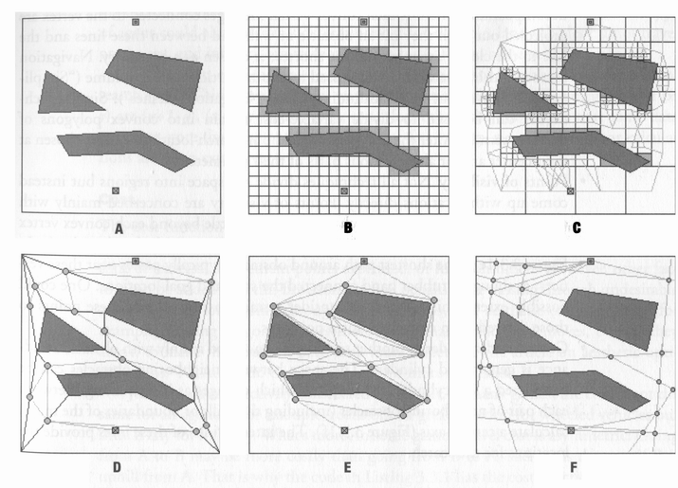
World Representation

Slide 6
A* Algorithm (A-Star)
A* is a general purpose search algorithm that can be used to find the shortest path from point A to B
Based on a graph (map) of nodes connected by links
Can also handle arbitrary ‘cost’ functions to determine best path
Nodes are assigned three main attributes: f, g, & h (fitness, goal, and heuristic values).
  g: cost to get to this node from the start node
  h: heuristic guess of the cost from this node to the goal
  f: the sum of g & h representing the best guess for the cost of the path going through this node. The lower the f , the better we think the path is

Slide 7
A* Algorithm
1. Let P=the starting point.
2. Assign f, g, and h values to P.
3. Add P to the Open list. At this point, P is the only node on the Open list.
4. Let B=the best node from the Open list (the best node has the lowest f-value).
a. If B is the goal node, the quit- a path has been found.
b. If the Open list is empty, then quit- a path cannot be found.
5. Let C=a valid node connected to B.
a. Assign f, g, and h values to C.
b. Check whether C is on the Open or Closed list.
i. If so, check whether the new path is more efficient (lower f-value).
1. If so, update the path.
ii. Else, add C to the Open list.
c. Repeat step 5 for all valid children of B.
6. Repeat from step 4.

Slide 8
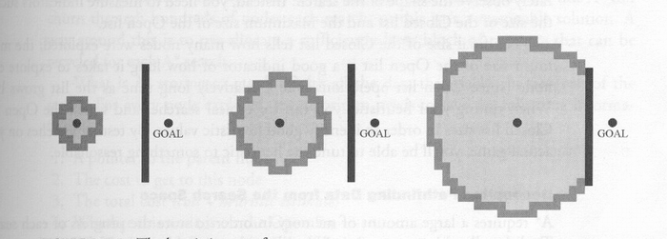
Unbiased A*

Slide 9
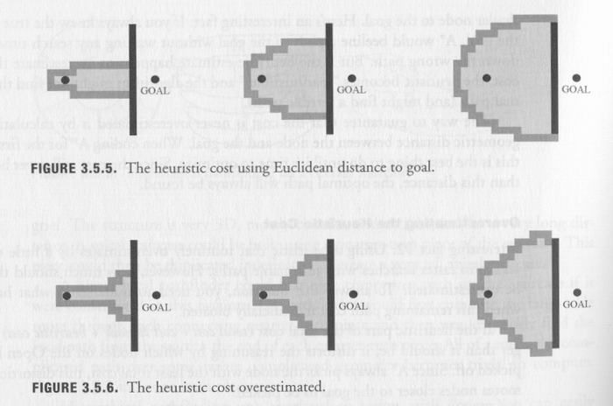
A* Heuristics

Slide 10
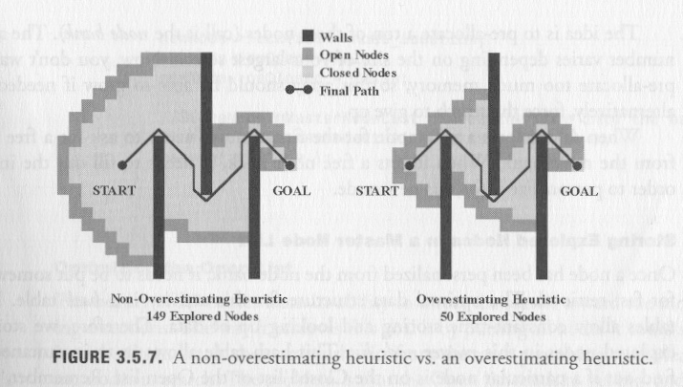
A* Heuristics

Slide 11
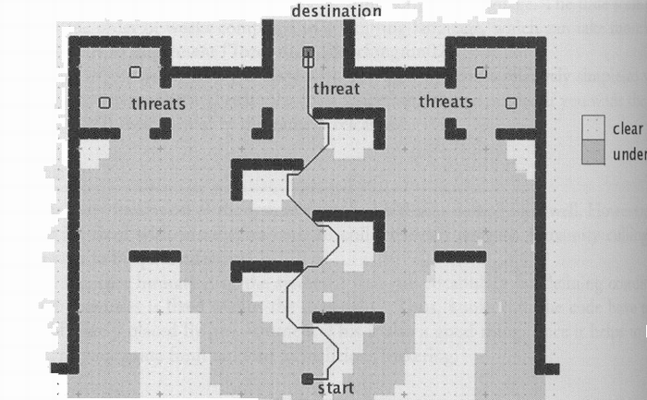
Tactical A*

Slide 12
A* Optimization
In games with lots of entities navigating around in a complex, dynamic environment, A* path planning can become the dominant computational cost
Intelligent biasing
Time slicing
Straight paths
Hierarchical A*
Waypoints

Slide 13
AI Optimization Strategies
From Steve Rabin in “Game Programming Gems 2”:
Use event driven behavior rather than polling
Reduce redundant calculations
Centralize cooperation with managers
Run the AI less often
Distribute the processing over several frames
Employ level-of-detail AI
Solve only part of the problem
Do the hard work offline
Use emergent behavior to avoid scripting
Amortize query costs with continuous bookkeeping
Rethink the problem

Slide 14
Environment Awareness
Potential Fields
Obstacle avoidance
Voronoi Diagrams

Slide 15
Flocking
Every entity can see only the other entities nearby and within its field of view
Entities try to match average position & velocity of other entities in view
Other behaviors can be added (collision avoidance, follow the leader…)
“Flocks, Herds, and Schools: A Distributed Behavior Model”, Craig Reynolds, SIGGRAPH, 1987

Slide 16
Misc Navigation
‘Popcorn trails’
Following
Wander
Wall crawling
B-line

Slide 17
Behavior

Slide 18
Control
Usually, AI’s are given a similar interface to controlling a vehicle/character as the player has:
class Car {
void SetGas(float g);
void SetSteering(float s);
void SetBrake(float b);
void SetGear(int g);
};

Slide 19
Rule Based Behavior
Line of sight
Hearing
Reaction to events

Slide 20
Decision Trees
A decision tree is a complex tree of if-else conditions
A decision is made by starting at the root and selecting each child based on a condition. A leaf node represents a final decision
DT’s can be constructed automatically based on input data (ID3 & C4.5 algorithms)

Slide 21
Scripting

Slide 22
State Machines
Behaviors are represented by states and can transition to other states based on rules
Exactly one state is active at any time
Even simple behaviors may require a series of distinct steps
State machines can be designed by game designers, but could also be procedurally constructed in certain situations (i.e., planning)

Slide 23
Message Systems

Slide 24
Subsumption
In the subsumption approach, an entity has several distinct behaviors it could do, but it is usually restricted to one at a time.
Every behavior first generates an ‘importance’ value based on its current situation.
After all behaviors are tested, the one with the highest importance is allowed to apply its control to the entity.
Example behaviors:
  Wander
  Follow
  Avoid collision
  Avoid enemy
  Find food
  Sleep

Slide 25
Subsumption
class Entity {
void SetGoalVelocity(Vector3 v); // or some more elaborate control scheme
};
class Behavior {
Behavior(Entity &e);
virtual float ComputeImportance();
virtual void ApplyControl();
};
class SubsumptionBrain {
SubsumptionBrain(Entity &e);
void AddBehavior(Behavior *b);
void RunAI();
};

Slide 26
Animation
It is worth noting that a lot of intelligent behavior can be conveyed through canned animation or simple procedural animations
There are some interesting similarities between animation & AI systems

Slide 27
Additional Topics
Genetic Algorithms
Reasoning & belief networks
Strategic planning
Neural networks

Slide 28
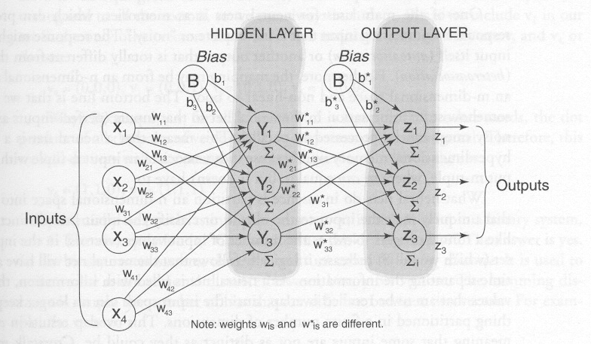
Neural Networks

Slide 29
New Possibilities
Speech recognition
Speech synthesis
Computer vision
  Facial recognition
  Expression (emotion) recognition
  Posture, motion recognition

Slide 30
Conclusion

Slide 31
Preview of Next Week
Visual effects
Lighting
Particle effects
Vertex & pixel shaders

Slide 32
Reading Assignment
“Real Time Rendering”, Chapter 5 & 6

Slide 33
AI References
“AI Game Programming Wisdom”, Rabin
“Game Programming Gems I, II, & III”, DeLoura
“Artificial Intelligence: A Modern Approach”
“Computational Principles of Mobile Robotics”, Dudek, Jenkin

